Slide 1
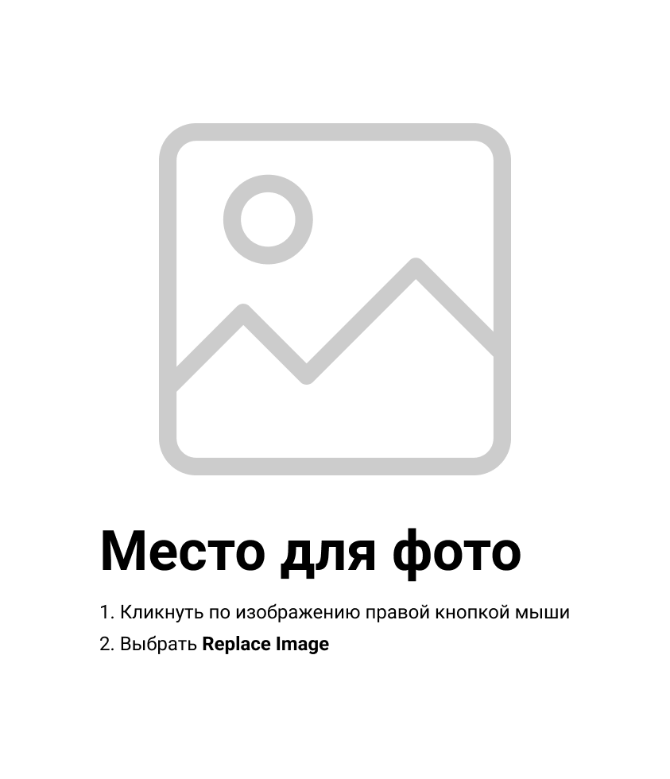

Daria Solodey
Methodist, course creator

Slide 2

Lesson Plan:
IT slang, abbreviations
Notes:
Развернутый комментарий.

Slide 3

What is an abbreviation?
What abbreviations do you know?
Do you know what the abbreviations in the picture mean?
Match the abbreviations with the meanings

Slide 4
LOL - laughing out loud
ROTFL - rolling on the floor laughing
PLZ - please
THX - thanks
BTW - by the way
GR8 - great
BRB - be right back
ASAP - as soon as possible
CUL8R - see you later
XOXO - hugs and kisses
WTF - what a f***k

Slide 5
One person names any abbreviation from the list, another says its meaning. You should name the abbreviation and give its meaning as quickly as possible. The person who stumbles is played out.
Game is on!

Slide 6
Match the words with the examples in WordWall.
1. 404
2. Breadcrumbs
3. CKI error
4. Sandbox
5. Wired (in)
6. Kludge

Slide 7
Make up your own examples.
1. 404
Don't bother asking Nick. He's 404.
2. Breadcrumbs
I’m so lost. Can we use breadcrumbs to find our way back to where we came from?
3. CKI error
That's a simple CKI error, sir. Just plug that mouse in and you're ok.
4. Sandbox
Internet Explorer tried to install some malicious software, but its process was contained inside Sandbox.
5. Wired (in)
Steve, ask Luke if he wants to come to the pub. - I wouldn't, he's wired in atm (at the moment)!
6. Kludge
This code is a total kludge!

Slide 8
What do we need abbreviations in the chats for?
Is it common to use abbreviations?
What are slang words? Why do natives use them?
Is there a slang in IT? Do you remember any IT slang words?
You’re divided into 2 teams. One is for slang, another is against of it. Present your arguments with proofs. You have some minutes to think.
1..2..3.. Let’s get started!

Slide 9

What can you do after this lesson?
I learned:
IT slang, abbreviations
Notes:
Развернутый комментарий

Slide 10
Useful links:
Games:
Slang
Abbreviations

Slide 11
Look through the dialogue and guess what the words mean
TIL
pissed off
Afk
ASAP
1337 alpha geek
LMAO
leech
Imho
N00b
Ftw
ROTFL
L8R
❓
Additional task

Slide 12
Have a look at the article from your HW. What is it about?
Name the slang words there and their meanings.

Slide 13
Thank you!

